Slide 1
Financial Math
Only include topic and EQ!!!!
Topic: Profit and Loss
EQ: How do we work out profit and loss?
Mrs Stretch
Year 8

Slide 2

Last Lesson Recap

Slide 3
Cost Price
Sale Price
Selling Price
GST
Financial Math
Profit
Loss
Discount
Mark Up
Notes:
Cost price (CP): the total cost of making or buying the goods
Selling price (SP): cost price + mark up
Mark up: amount added to cost price in order to make a profit
Discount: decrease in the selling price to attract more buyers
Sale price = selling price – discount amount
GST: Goods and Services Tax of 10% added to selling price
Profit: difference between SP and CP, where SP > CP
Loss: difference between SP and CP where SP < CP

Slide 4
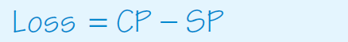
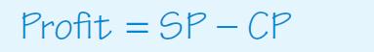


Profit and Loss Formulas
$$Loss=\frac{Loss in \$}{Cost Price}×100$$
$$Profit=\frac{profit in \$}{Cost Price}×100$$

Slide 5
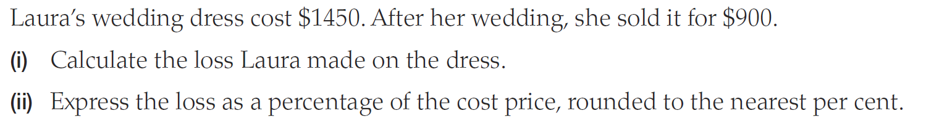

How to Calculate Loss
$$Loss=\frac{Loss in \$}{Cost Price}×100$$

Slide 6
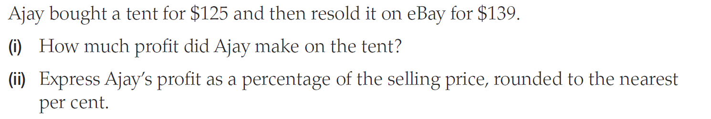

How to Calculate Profit
$$Profit=\frac{profit in \$}{Cost Price}×100$$

Slide 7


Slide 8
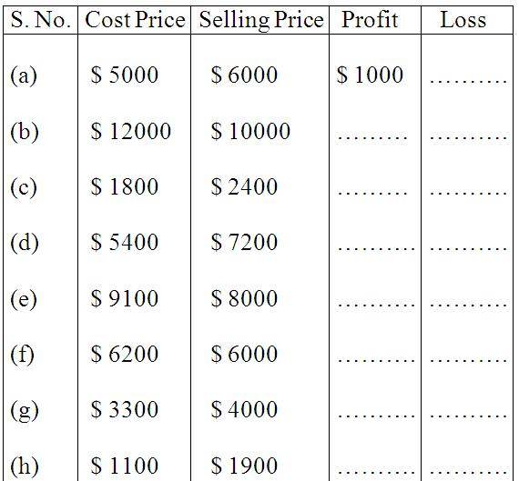
Worksheet
Notes:
a.

Slide 9
A TV was bought for $ 18,950 and sold at a loss of $ 4780. Find the selling price.
A second-hand car was sold for $ 190,000, at a loss of $ 85. Find the CP of the car.
Jane sold her genset for $ 20000 at a profit of $ 1737. Find the CP of genset.

Slide 10
Abraham bought a music system for $ 6375.00 and spent $ 75.00 on its transportation He sold it for $ 6400.00. Find his profit or loss percent.
Joy bought pens at $ 120 a dozen. He sold it for $ 15 each. What is his profit percent?
Simi bought a study table for $ 9000. She sold it at a profit of 20%. How much profit did she make? What is the selling price?

Slide 11
Find the selling price if the cost price is $ 1200 and loss percent is 25.
Marshall bought 20 refills and sold them at $ 4 each. If it had cost $ 50 for the refills, what was his profit or loss percent?
Mr. Smith buys pencils at $ 250 per hundred and sells each at $ 1.75. Find his loss or profit.

